Slide 1
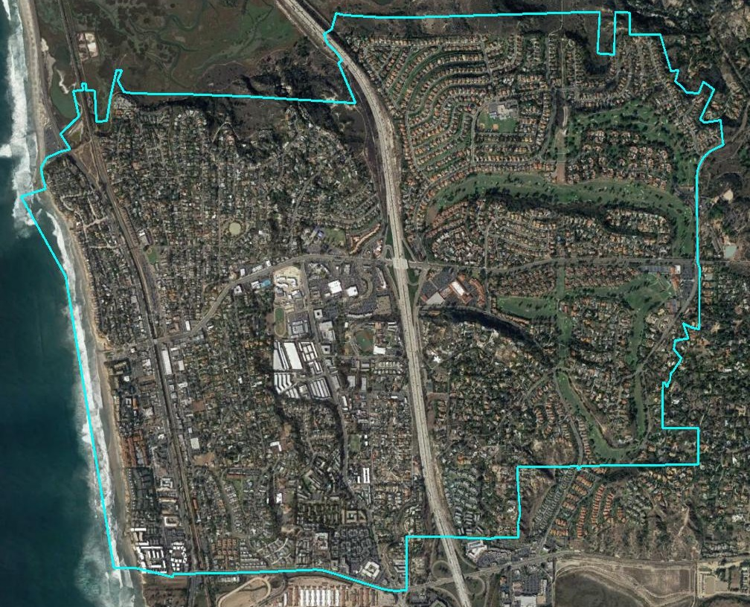
City of Solana Beach Introduction to Districting

Slide 2
California Voting Rights Act (CVRA)
Under the Federal Voting Rights Act (passed in 1965), a jurisdiction must fail 4 factual tests before it is in violation of the law.
The California VRA makes it significantly easier for plaintiffs to force jurisdictions into “by-district” election systems by eliminating two of the US Supreme Court Gingles tests:
Can the protected class constitute the majority of a district?
Does the protected class vote as a bloc?
Do the voters who are not in the protected class vote in a bloc to defeat the preferred candidates of the protected class?
Do the “totality of circumstances” indicate race is a factor in elections?
Liability is now determined only by the presence of racially polarized voting

Slide 3
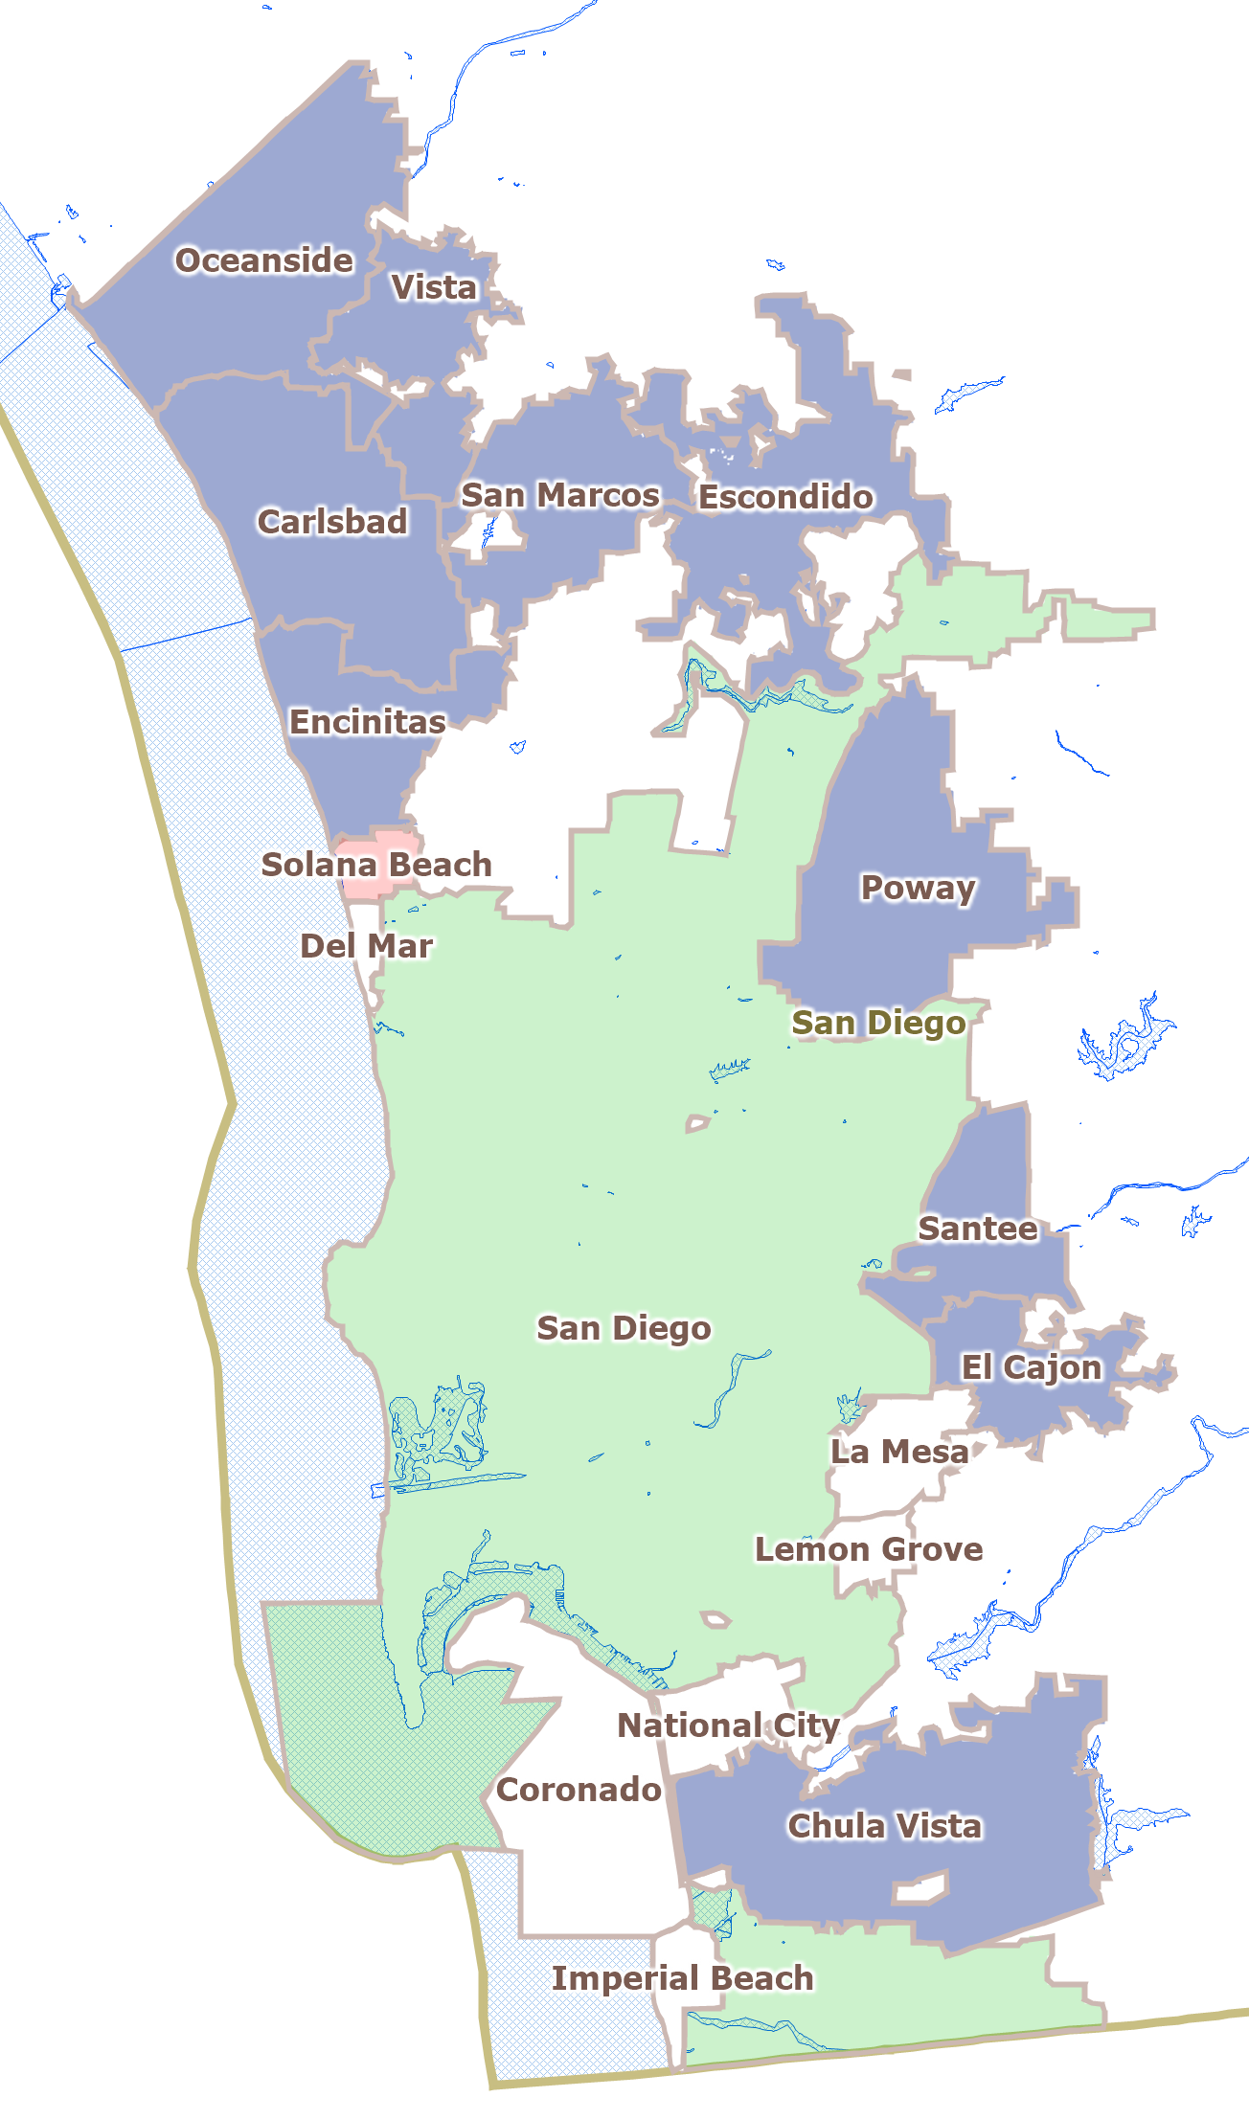
CVRA Impact
Switched (or in the process of switching) as a result of CVRA:
At least 160 school districts
Over 80 cities
1 County Board of Supervisors
Numerous college, water and other special districts.
Key decisions & settlements
Only Palmdale has gone to trial on the merits (they lost)
Key settlements:
Palmdale: $4.7 million
Modesto: $3 million
Whittier: $1 million
Tulare Hospital: $500,000
Merced City: $42,000
Placentia: $20,000
Map Color Key:
Blue: By-District after CVRA challenge
Green: By-District before CVRA
White: Still At-Large

Slide 4

Elections Code 10010 Process
Date | Action
April 11 | Adopt ‘resolution of intent’ and criteria, set schedule, and begin waiver process
May 14 and 15 | Hold two hearings to gather public input on communities of interest (no draft maps drawn until these are complete)
May 23 | Draw and distribute draft maps
May 30 | Public hearing to gather public input on draft maps and election sequencing
June 26 | Council public hearing & introduction of ordinance
July 11 | Public hearing, second reading and adoption of ordinance
November 2020 | First two (and separately elected Mayor) or first three districts hold elections
2021 | Map redrawn to reflect 2020 Census data
November 2022 | Remaining two districts hold elections

Slide 5
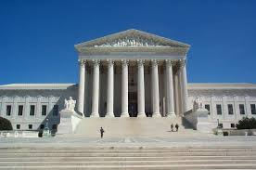
Districting Criteria
Federal Laws
Traditional Redistricting Principles
Equal Population
Federal Voting Rights Act
No Racial Gerrymandering
Communities of interest
Compact
Contiguous
Visible (Natural & man-made) boundaries
Respect voters’ choices / continuity in office
Planned future growth

Slide 6
Demographic Summary
Latinos are 16% of the total population and 8% of the eligible voters (measured by Citizen Voting Age Population data).
Asian-Americans are 5% of total population and 5% of eligible voters.
In a five-district map, each district would have about 2,573 residents.

Slide 7

Defining Communities of Interest
1st Question: what is your neighborhood or community of interest?
A Community of Interest is generally defined as a neighborhood or community of shared interests, views, problems, or characteristics. Possible community feature/boundary definitions include:
School attendance areas
Natural neighborhood dividing lines, such as highway or major roads, rivers, canals, and/or hills
Areas around parks and other neighborhood landmarks
Common issues, neighborhood activities, or legislative/election concerns
Shared demographic characteristics
Such as similar levels of income, education, or linguistic isolation
2nd Question: Does a Community of Interest want to be united in one district, or to be divided to have a voice in multiple elections?

Slide 8
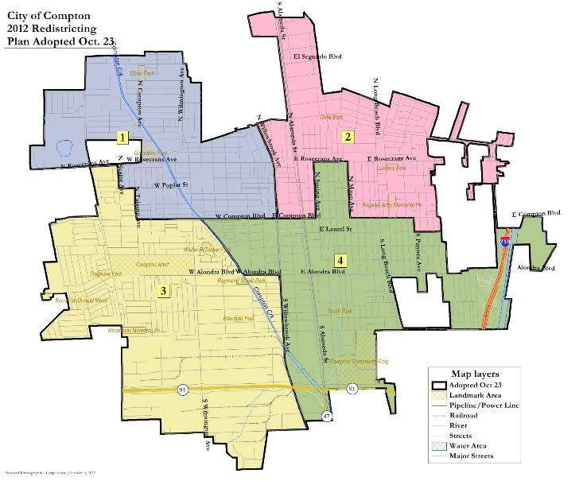
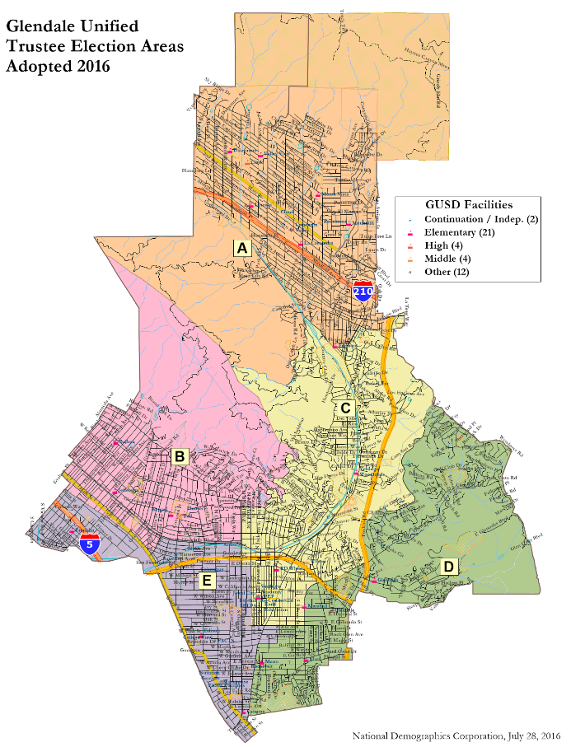
Sample Compact Maps
Compton
Glendale
Unified
Examples of highly compact maps, with nooks and jogs driven only by equal population requirements.

Slide 9
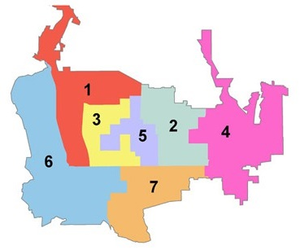
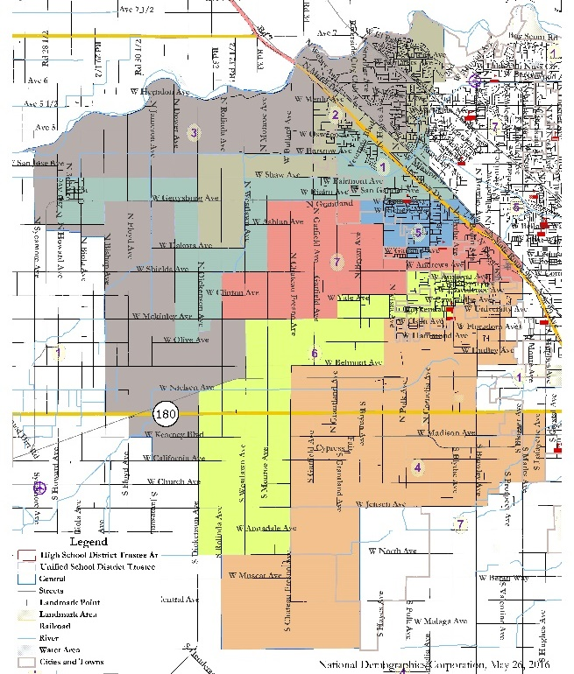
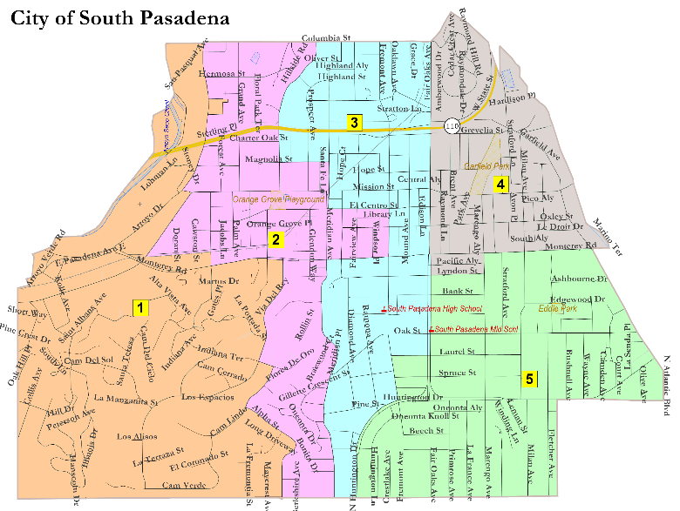
Sample Multiple-Representative Maps
Pasadena
Colorado Blvd.
Examples of maps where a desire to have all members touch downtown (Pasadena) or rural areas (Central), or as many neighborhoods as possible (South Pas), led to policy-driven but non-compact maps.
Central Unified

Slide 10
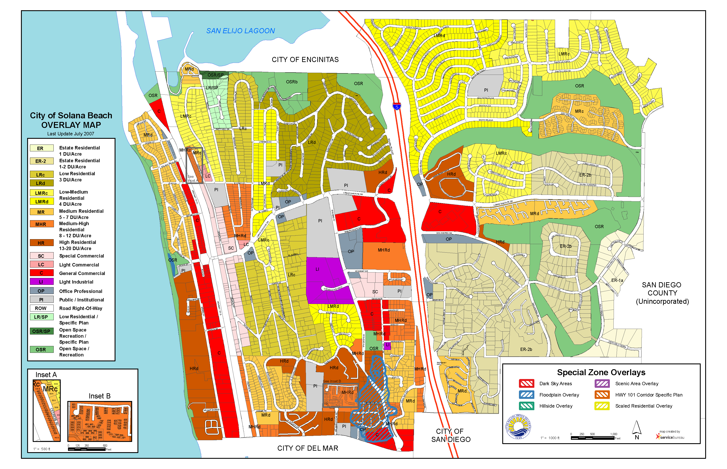
Zoning Map

Slide 11

Public Hearing & Discussion
What is your neighborhood or “community of interest”
Do you prefer your neighborhood be kept together in one district or have multiple representatives?
What are other communities of interest in the City that should be considered when drafting maps?

